Slide 1
Car Condition Predictor
As the standard of living of people is improving, the threat to nature is also increasing.
The major threat is global warming caused by the CO2 emitted from vehicles.
So the production of CO2 must be minimized.
This model will help to predict whether a car require some mainteinance or not.

Slide 2
Objectives
The main objective of this model is to reduce the amount of CO2 produced by predicting whether the vehicle status.
Another objective is to suggest the various car companies about certain changes in their product manufacturing.

Slide 3
Dataset description
This dataset is taken from one of the competetions of Kaggle which is a well known organisation for data science and machine learning.
This dataset was developed by Debajyoti Podder, who is pursuing PGP in Data science.
This dataset contains 7386 rows with 12 columns.
This dataset has mainly 2 types of attributes which are as follows:-
Numerical => Engine Size(in L),number of cylinders, Fuel Consumption City(in gm/100km), Fuel Consumption Highway(in gm/100km), Fuel Consumption Comb(in gm/100km), Fuel Consumption City(in mpg).
Categorical=> Make , Vehicle Class, Fuel Type, Model, Transmission.

Slide 4
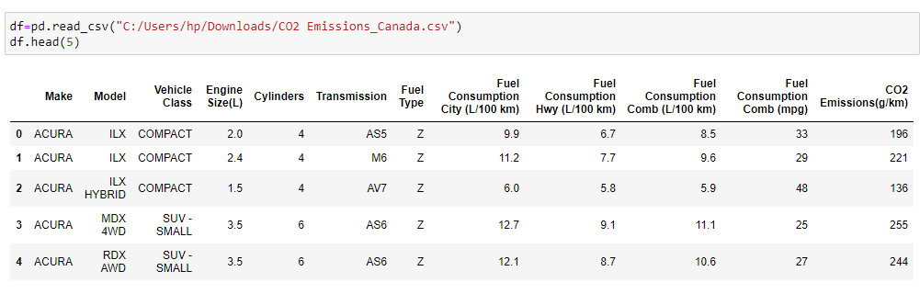
Dataset Overview

Slide 5
Data Visualization using tableau
Tableau is a popular BI tool used for exploratory data analysis.
The reason behind such heavy usage is the variety of graphs and plots it provides rather than python inbuilt packages like seaborn and matplotlib.
Another reason is that the visualization done in tableau is more efficient and self explanatory.

Slide 6
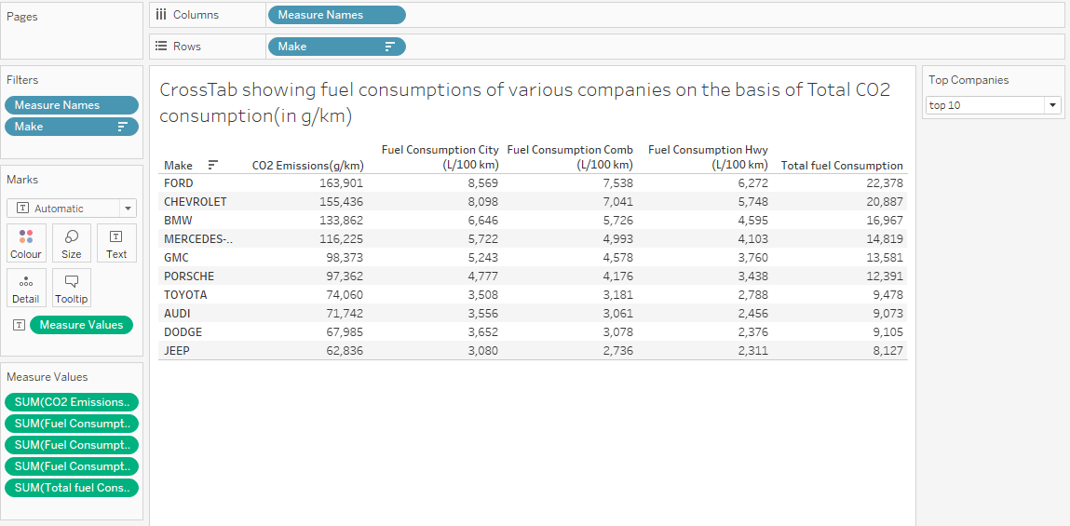
Visualization 1

Slide 7
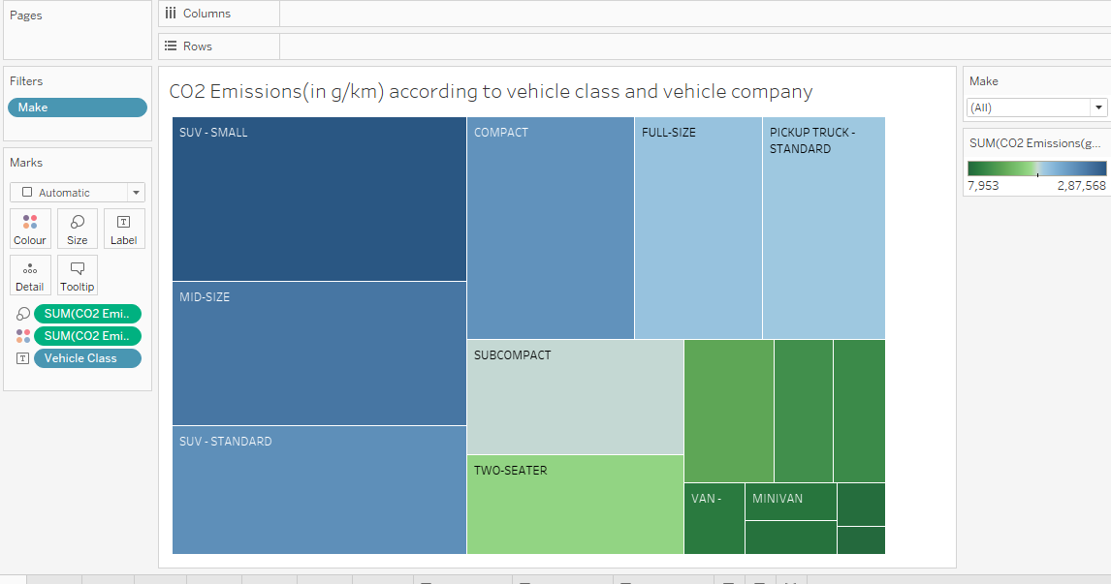
Visualization 2

Slide 8
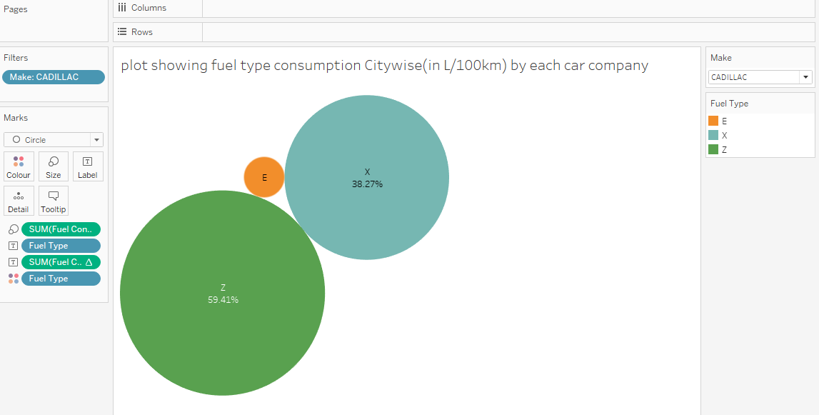
Visualization 3

Slide 9
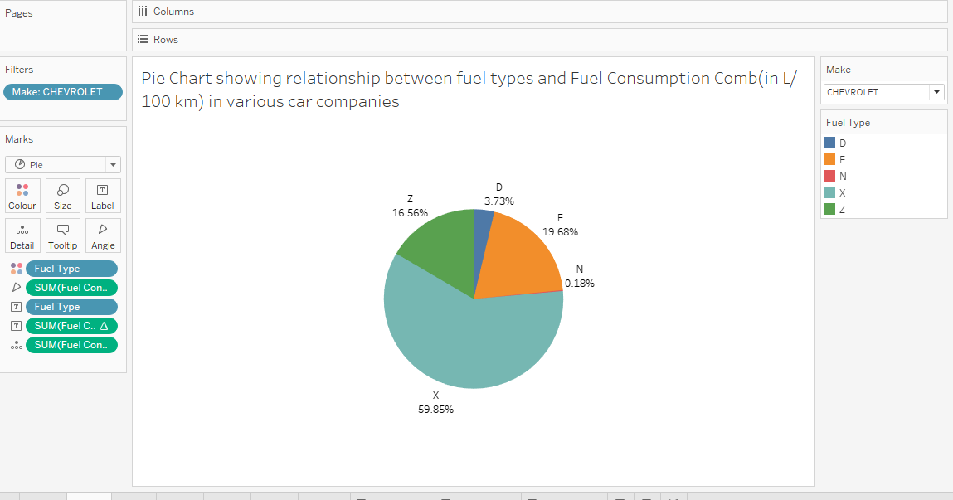
Visualization 4

Slide 10
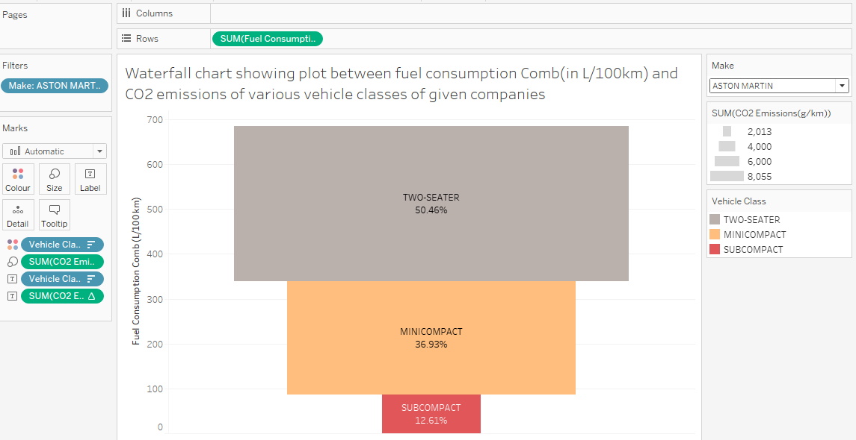
Visualization 5

Slide 11
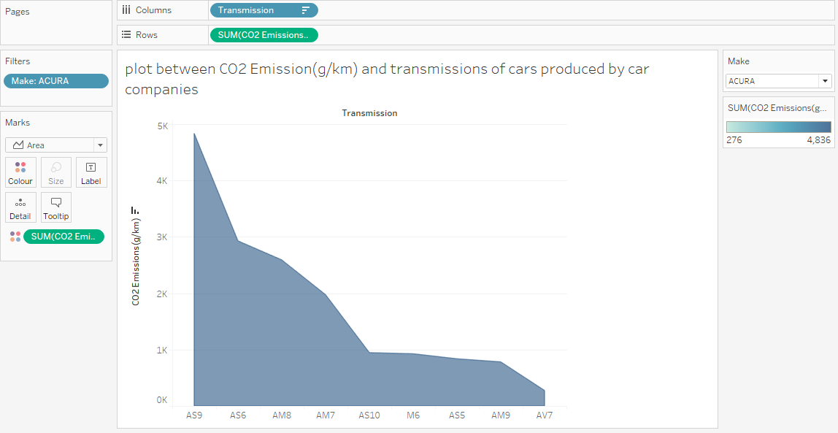
Visualization 6

Slide 12
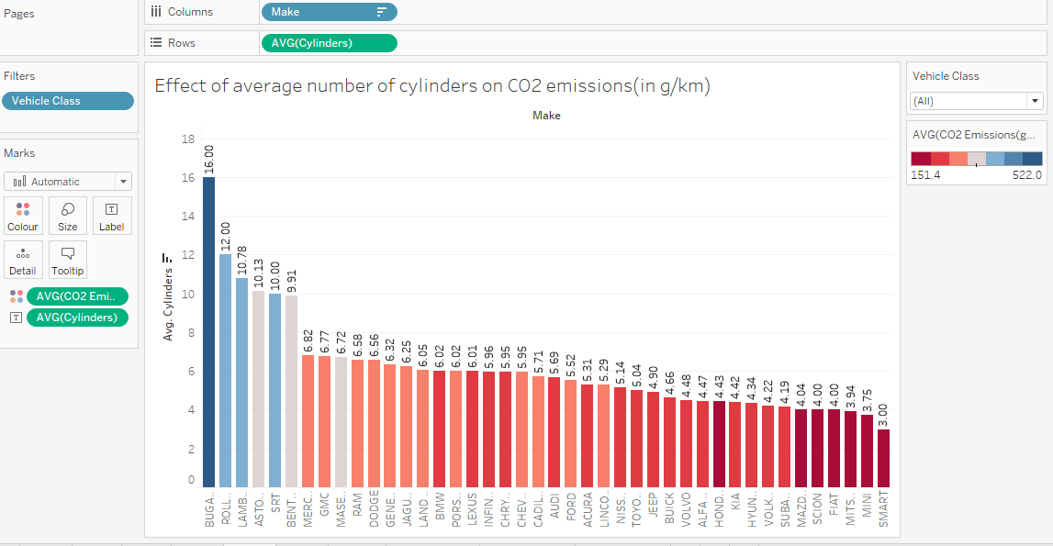
Visualization 7

Slide 13
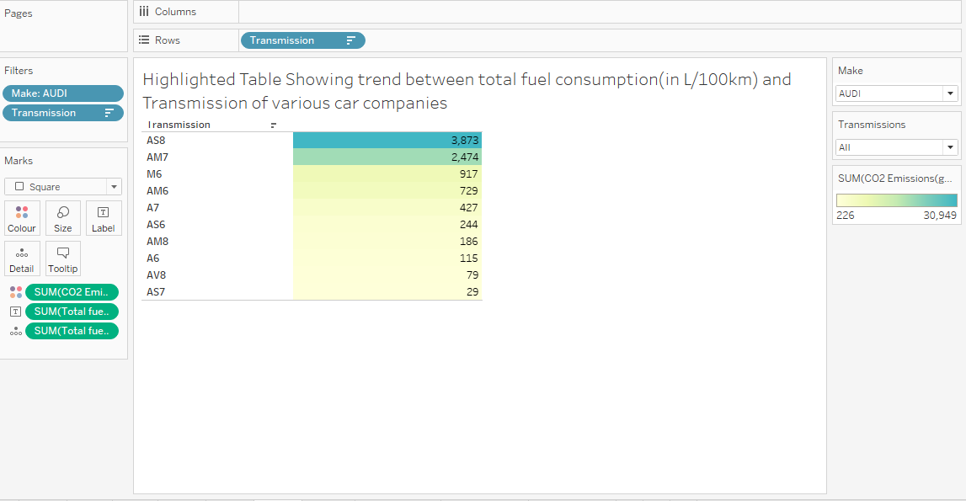
Visualization 8

Slide 14
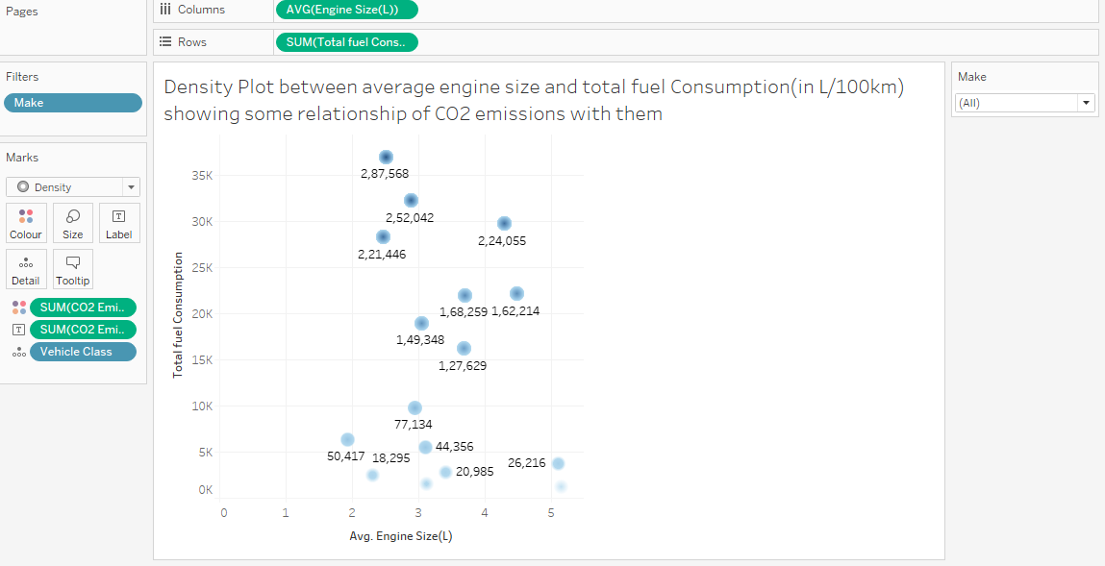
Visualization 9

Slide 15
Multiple Linear Regression
In multiple Linear Regression, the dependent variable varies with more than one features.
So the equation is given by y=b0+b1x1+b2x2+….
Where b1,b2,b3… are the weights on input and b0 is the bias value.
In this Model ,Multiple linear Regression model is used as a base model(Scope of improvement is possible).

Slide 16
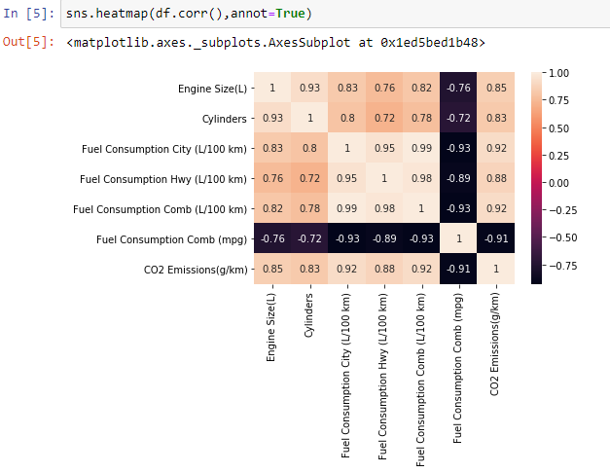
Finding out dependent and independent variables
The heatmap is drawn below shows some valuable information:-
Here fuel consumption comb(in mpg) is negatively corelated to all the attributes,so it will distort the accuracy .so this attribute is neglected.
Also CO2 emissions(in gm/km) is varying with all other numerical attributes, CO2 emissions (in gm/km) is dependent attribute while other features are independent.

Slide 17
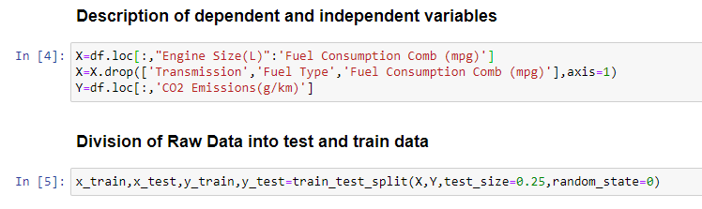
Splitting Data into test and train data
The data by which model is generated is called train data and the data on which trained model is tested is called test data.
Here the size of test data is 25% of the dataset while remaining 75% data is train data.
Following is the python command for splitting the data into test and train data.

Slide 18
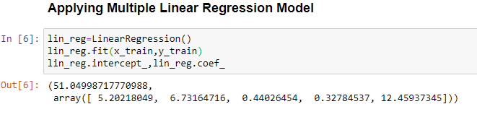
Generating Model Using Train data

Slide 19
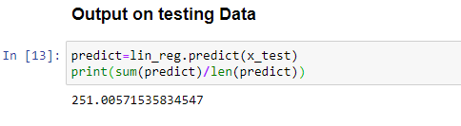
Prediction of output on testing data

Slide 20
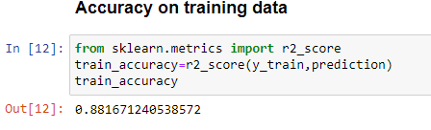
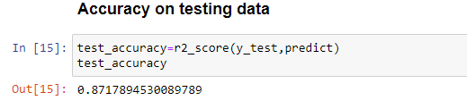
Accuracy on test and train data
Here Accuracy of model on training data is 88.1671240538572% and on testing data is 87.17894530089789%.
So Our Model works Fine.

Slide 21
GUI Interface
Tkinter is inbuilt python module for creating graphical user interface of the code.
It is easy to use and more efficient in terms of user interface.
Now the UI of this model is displayed in upcoming slides-:

Slide 22
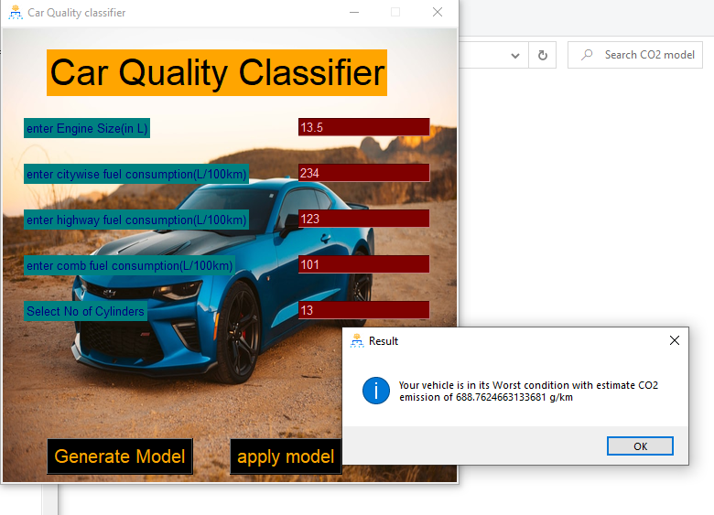
Snapshots of output

Slide 23
Resources
www.sklearn.com
www.towardsdatascience.com
www.Kaggle.com
www.python.org

